Slide 1
Lec00-Theory and Implementation of Programming Language Spring 2024 Introduction
ispace.xjtu.edu.cn
Professor Li,Bo(李波)
boblee@xjtu.edu.cn,13709218618
School of Computer Science and Technology
Xi’an Jiaotong University

Slide 2
Topic
Course Goals
Schedule
Grading System
Reading Lists of Paper
Reference books
Programming Language

Slide 3
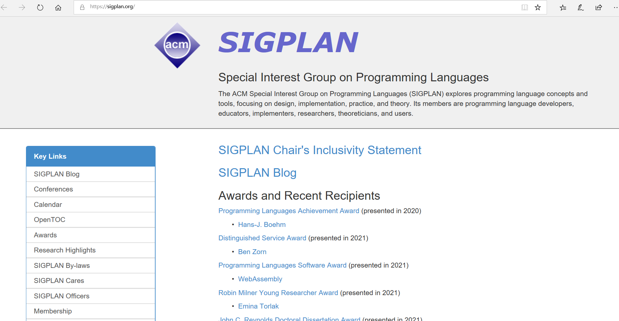

Slide 4
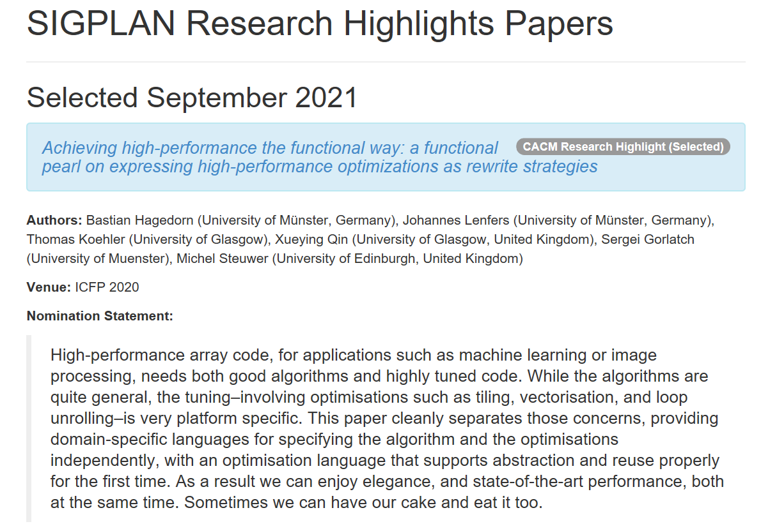

Slide 5
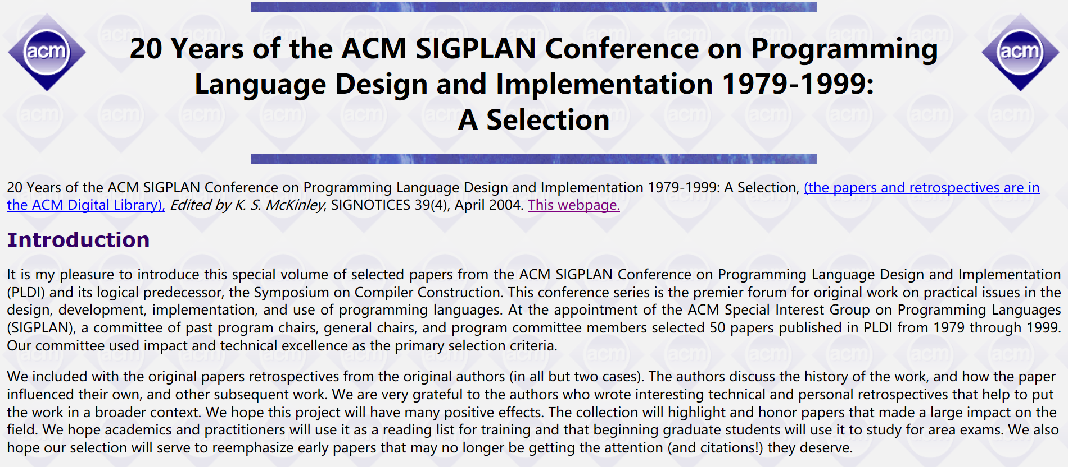

Slide 6
Course Goals
Programming Language Concepts
Language and implementation
Critical thought

Slide 7
Why Study Principles of Programming Languages?
Because they are fundamental to the design, implementation, and application of programming languages.
Notes:
This is a course on the principles of programming languages. Why study these principles? Because they are fundamental to the design, implementation, and application of programming languages.

Slide 8
Course Goals
Programming Language Concepts
A language is a “conceptual universe” (Perlis)
Framework for problem-solving
Useful concepts and programming methods
Understand the languages you use, by comparison
Appreciate history, diversity of ideas in programming
Be prepared for new programming methods, paradigms, tools
Notes:
universe ['ju:nivə:s]
基本翻译
n. 宇宙；世界；领域
网络释义
universe:宇宙 | 总体 | 全世界

Slide 9
Value of Language Concepts
Ancient history
I started programming in 1980’s
Dominant language was Fortran; no recursive functions
My algorithms and data structure instructor said:
Recursion is a good idea even though inefficient
You can use idea in Fortran by storing stack in array
Today: recursive functions everywhere
Notes:
Parable寓言
Moral 道德
monads

Slide 10
Value of Language Concepts
Futuristic ideas
Useful problem-solving methods now, and may be part of languages you use in the future
Current examples
Function passing: pass functions in C by building your own closures, as in STL “function objects”
Continuations: used in web languages for workflow processing
Monads: programming technique from functional programming
Evaluation strategy-Lazy Evaluation
Concurrency-many cores
Notes:
Parable寓言
Moral 道德
Monads
Continuations in Web development
One area that has seen practical use of continuations is in Web programming.[1][2] The use of continuations shields the programmer from the stateless nature of the HTTP protocol. In the traditional model of web programming, the lack of state is reflected in the program's structure, leading to code constructed around a model that lends itself very poorly to expressing computational problems. Thus continuations enable code that has the useful properties associated with inversion of control, while avoiding its problems. Inverting back the inversion is a paper that provides a good introduction to continuations applied to web programming.
Some of the more popular continuation-aware Web servers are the PLT Scheme Web Server(documentation), the UnCommon Web Framework and Weblocks Web framework for Common Lisp, the Seaside framework for Smalltalk, Ocsigen/Eliom for OCaml, Continuity for Perl, Wee for Ruby, and the Nagare framework for Python. The Apache Cocoon Web application framework also provides continuations (see the Cocoon manual).

Slide 11
Course Goals
Language and implementation
Every convenience has its cost
利害-享其利必受其害
得失
Recognize the cost of presenting an abstract view of machine
Understand trade-offs in programming language design
Critical thought
Identify properties of language, not syntax or sales pitch

Slide 12
Q1:How to Measuring programming language popularity?

Slide 13
It is difficult to determine which programming languages are most widely used, and what usage means varies by context.
Various methods of measuring language popularity, each subject to a different bias over what is measured, have been proposed:
counting the number of times the language name is mentioned in web searches. (see Google Trends)
counting the number of job advertisements that mention the language
the number of books sold that teach or describe the language
estimates of the number of existing lines of code written in the language—which may underestimate languages not often found in public searches
counts of language references (i.e., to the name of the language) found using a web search engine
counting the number of projects in that language on SourceForge and GitHub.
Notes:
One language may occupy the greater number of programmer hours, a different one have more lines of code, a third may utilize the most CPU time, and so on. Some languages are very popular for particular kinds of applications. For example, COBOL is still strong in the corporate data center, often on large mainframes; FORTRAN in engineering applications; C in embedded applications and operating systems; and other languages are regularly used to write many different kinds of applications.

Slide 14

Several indices have been published
The monthly TIOBE Programming Community Index has been published since 2001, and shows the top 10 languages' popularity graphically, the top 20 languages with a rating and delta, and the top 50 languages' ratings. The numbers are based on searching the Web with certain phrases that include language names and counting the numbers of hits returned.
The Language Popularity Index is based on a similar approach, however in a transparent way: counts for all {search engine, language} pairs are published. An open source tool for grabbing counts from search engines is provided as well, so the rankings can be reproduced and verified. It does not show historical trends.
The PYPL Popularity of Programming Language is based on Google Trends. It is thus based on what developers actually search on the web, instead of what pages are available. It shows the popularity trends since 2004.

Slide 15
The TIOBE Programming Community index
An indicator of the popularity of programming languages.
The index is updated once a month.
The ratings are based on the number of skilled engineers world-wide, courses and third party vendors.
Popular search engines such as Google, Bing, Yahoo!, Wikipedia, Amazon, YouTube and Baidu are used to calculate the ratings.
It is important to note that the TIOBE index is not about the best programming language or the language in which most lines of code have been written.
The index can be used to check whether your programming skills are still up to date or to make a strategic decision about what programming language should be adopted when starting to build a new software system.
The definition of the TIOBE index can be found here.
https://www.tiobe.com/tiobe-index/

Slide 16
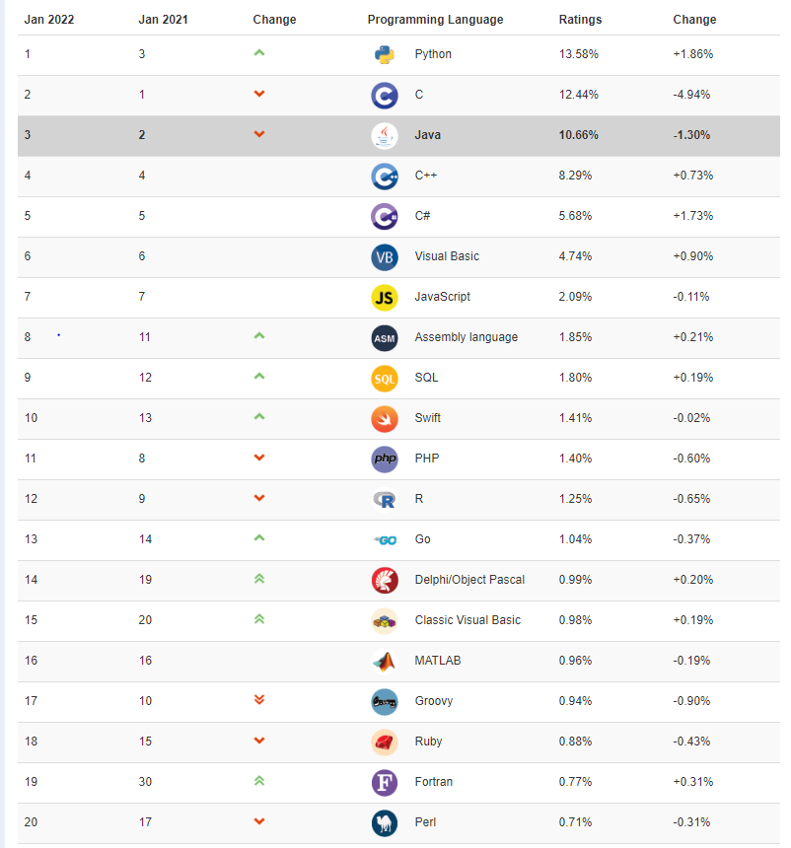
TIOBE Index for January 2022
January Headline: Python Programming Language of the Year 2021
Python has won the prestigious TIOBE Programming Language of the Year award. Congratulations! This is the second time in a row. The award is given to the programming language that has gained the highest increase in ratings in one year. C# was on its way to get the title for the first time in history, but Python surpassed C# in the last month.
Python started at position #3 of the TIOBE index at the beginning of 2021 and left both Java and C behind to become the number one of the TIOBE index. But Python's popularity didn't stop there. It is currently more than 1 percent ahead of the rest. Java's all time record of 26.49% ratings in 2001 is still far away, but Python has it all to become the de facto standard programming language for many domains. There are no signs that Python's triumphal march will stop soon.
Notes:
TIOBE Index for January 2022
January Headline: Python Programming Language of the Year 2021
Python has won the prestigious TIOBE Programming Language of the Year award. Congratulations! This is the second time in a row. The award is given to the programming language that has gained the highest increase in ratings in one year. C# was on its way to get the title for the first time in history, but Python surpassed C# in the last month.
Python started at position #3 of the TIOBE index at the beginning of 2021 and left both Java and C behind to become the number one of the TIOBE index. But Python's popularity didn't stop there. It is currently more than 1 percent ahead of the rest. Java's all time record of 26.49% ratings in 2001 is still far away, but Python has it all to become the de facto standard programming language for many domains. There are no signs that Python's triumphal march will stop soon.
Are there any serious contenders for Python? Any new and shiny languages that might compete in the future? If we look at the promising languages of the last few years, we see the following changes in 2021: Swift from #13 to #10, Go from #14 to #13, Rust from #26 to #26, Julia from #23 to #28, Kotlin from #40 to #29, Dart from #25 to #37, and TypeScript from #42 to #49. So, except may be for Swift and Go, we don't expect any new languages entering the top 5 or even the top 3 any time soon.

Slide 17
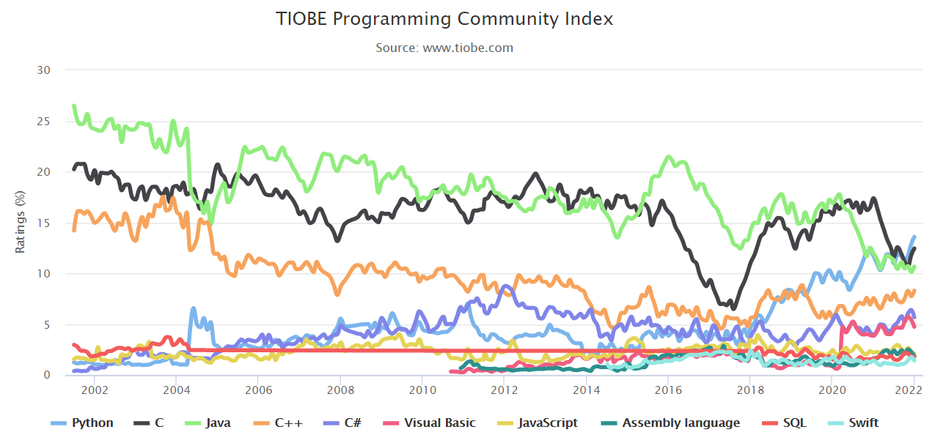
History

Slide 18
Programming Language | 2016 | 2011 | 2006 | 2001 | 1996 | 1991 | 1986
Java | 1 | 1 | 1 | 3 | 30 | - | -
C | 2 | 2 | 2 | 1 | 1 | 1 | 1
C++ | 3 | 3 | 3 | 2 | 2 | 2 | 8
C# | 4 | 5 | 6 | 10 | - | - | -
Python | 5 | 6 | 7 | 26 | 15 | - | -
PHP | 6 | 4 | 4 | 21 | - | - | -
JavaScript | 7 | 10 | 9 | 7 | 32 | - | -
Visual Basic .NET | 8 | 191 | - | - | - | - | -
Objective-C | 9 | 8 | 43 | - | - | - | -
Perl | 10 | 7 | 5 | 4 | 3 | - | -
Ada | 25 | 22 | 15 | 17 | 6 | 9 | 3
Lisp | 26 | 13 | 13 | 19 | 5 | 3 | 2

Slide 19
TIOBE Index for February 2021
February Headline: it seems like nothing really changes
Some say that the IT industry is changing continuously. Every day a new IT buzzword pops up somewhere. But if we take a closer look at the top 8 of the TIOBE index, it appears to be unchanged for the last 7 years. Does this mean that the programming language world hasn't change over the last years? Of course it has changed. Except for language C, all programming languages in the top 8 are releasing new versions frequently. For instance C#, which releases a language update almost every year. Or JavaScript, which changes so fast that hardly anybody can follow. C++ is changing less frequently (once in 3 years), but its latest release contains the introduction of modules, which will cause a major shift in C++ programming.
It is interesting to note that positions 9 and 10 in the TIOBE index are not as fixed as the top 8. Languages come and go. The last 12 months, these 2 positions were occupied by SQL, Assembly, R, Groovy, Go, and Swift. I am curious to know which of these languages will become a steady top 10 player. - Paul Jansen CEO TIOBE Software
Feb 2021 | Feb 2020 | Change | Programming Language | Ratings | Change
1 | 2 |  | C | 16.34% | -0.43%
2 | 1 |  | Java | 11.29% | -6.07%
3 | 3 |  | Python | 10.86% | +1.52%
4 | 4 |  | C++ | 6.88% | +0.71%
5 | 5 |  | C# | 4.44% | -1.48%
6 | 6 |  | Visual Basic | 4.33% | -1.53%
7 | 7 |  | JavaScript | 2.27% | +0.21%
8 | 8 |  | PHP | 1.75% | -0.27%
9 | 9 |  | SQL | 1.72% | +0.20%
10 | 12 |  | Assembly language | 1.65% | +0.54%
11 | 13 |  | R | 1.56% | +0.55%
12 | 26 |  | Groovy | 1.50% | +1.08%
13 | 11 |  | Go | 1.28% | +0.15%
14 | 15 |  | Ruby | 1.23% | +0.39%
15 | 10 |  | Swift | 1.13% | -0.33%
16 | 16 |  | MATLAB | 1.06% | +0.27%
17 | 18 |  | Delphi/Object Pascal | 1.02% | +0.27%
18 | 22 |  | Classic Visual Basic | 1.01% | +0.40%
19 | 19 |  | Perl | 0.93% | +0.23%
20 | 20 |  | Objective-C | 0.89% | +0.20%

Slide 20
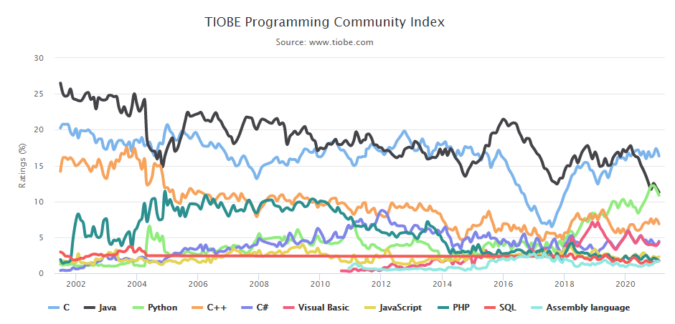

Slide 21
Feb 2016 | Feb 2015 | Change | Programming Language | Ratings | Change
1 | 2 |  | Java | 21.145% | +5.80%
2 | 1 |  | C | 15.594% | -0.89%
3 | 3 |  | C++ | 6.907% | +0.29%
4 | 5 |  | C# | 4.400% | -1.34%
5 | 8 |  | Python | 4.180% | +1.30%
6 | 7 |  | PHP | 2.770% | -0.40%
7 | 9 |  | Visual Basic .NET | 2.454% | +0.43%
8 | 12 |  | Perl | 2.251% | +0.86%
9 | 6 |  | JavaScript | 2.201% | -1.31%
10 | 11 |  | Delphi/Object Pascal | 2.163% | +0.59%
11 | 20 |  | Ruby | 2.053% | +1.18%
12 | 10 |  | Visual Basic | 1.855% | +0.14%
13 | 26 |  | Assembly language | 1.828% | +1.08%
14 | 4 |  | Objective-C | 1.403% | -4.62%
15 | 30 |  | D | 1.391% | +0.77%
16 | 27 |  | Swift | 1.375% | +0.65%
17 | 18 |  | R | 1.192% | +0.23%
18 | 17 |  | MATLAB | 1.091% | +0.06%
19 | 13 |  | PL/SQL | 1.062% | -0.20%
20 | 33 |  | Groovy | 1.012% | +0.51%
TIOBE Index for February 2016
February Headline: Java's growth hampers
The ratings of the Java programming language started to climb at the end of 2014 and continued until last month.
The TIOBE programming language of the year 2015 clearly has some struggles to continue its uprise in 2016. This unlike other programming languages such as Python and C++ that appear to grow in the short term.

Slide 22
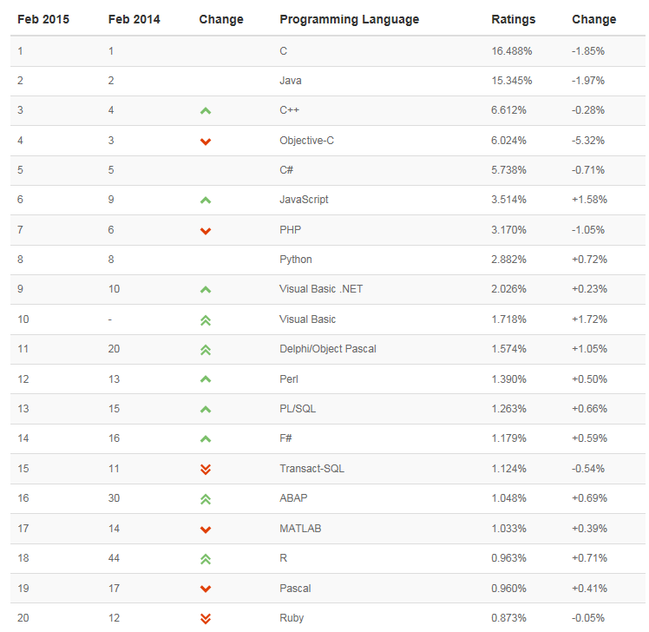
TIOBE Index for February 2015
February Headline: JavaScript at highest position ever
After having won the TIOBE programming language award of 2014 last month, JavaScript keeps going strong. This month it surpasses PHP and is now at position 6. This is JavaScript's highest position ever. On the other hand, Objective-C's days seem to be over. Objective-C lost more than 5% in one year's time and is now back at fourth position behind C++. Objective-C was in third place in the TIOBE index for more than 2.5 years.
Notes:
TIOBE Index for February 2016
February Headline: Java's growth hampers
The ratings of the Java programming language started to climb at the end of 2014 and continued until last month. The TIOBE programming language of the year 2015 clearly has some struggles to continue its rise in 2016. This is unlike other programming languages such as Python and C++ that appear to grow in the short term.

Slide 23
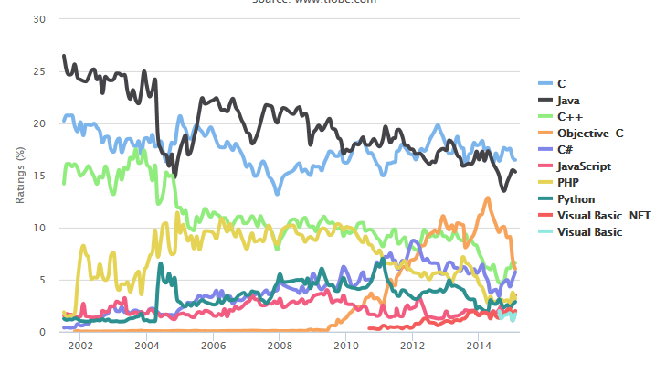

Slide 24
Q2:Which factors to consider for Designing a programming language?

Slide 25
Language goals and trade-offs
Architect
Programmer
Programming Language
Tester
Compiler,
Runtime environ-ment
DiagnosticTools

Slide 26
Q3:What’s new in programming languages
Commercial trend over past 5 years
Increasing use of type-safe languages: Java, C#, …
Scripting languages, other languages for web applications
Teaching trends
Java,Python,Script replaces C as most common intro language
Less emphasis on how data, control represented in machine
Research and development trends
Notes:
Cremains the most popular embedded programming language, and it has been number one for years. Still, your toolkit should include a bit more, especially when dealing with trends like the new and improved Internet plus heterogeneous and multicore systems. Some options in that toolkit might be scripting languages, parallel programming, and graphical programming.
Scripting languages started out on PCs and servers, but they're equally applicable to embedded systems (see "Using The Right Tools: Embedded Scripting And Other Ideas"). This is especially true for 32-bit systems that have the storage to handle the overhead of a scripting system.
Also, scripting languages tend to be more flexible and dynamic than C, making them easier to use for many parts of an application. Scripting languages like Perl, PHP, Python, and Javascript normally complement C and they often interact with each other, so it pays to know both sides of the fence.
Furthermore, scripting languages have been used on the server side in large enterprise applications. These applications often are spread across dozens of servers. But each instance tends to be relatively isolated, so they can be spread arbitrarily across the servers.
Taking advantage of an ever-growing number of cores will require programmers to take a larger role in coding parallel algorithms so cores can cooperate. Current programming languages can use frameworks like the message passing interface (MPI), but this approach requires significant effort at design time. The approach scales, but not necessarily as well as one would like if the system design isn't done right. This is one reason for the growing interest in parallel programming languages (see "Parallel Programming And Multicore Environments,").
The main difference between enhanced single-threaded languages like C with MPI and parallel programming research is that parallel programming research normally assumes implicit parallel execution. It's a bit premature to add languages in this area to your toolkit, but it's worth tracking to see when they will prove useful.
Graphical programming languages and environments like National Instruments' LabVIEW, MatLab's Simulink, and the Object Management Group's UML (unified modeling language) tend to extend programming toward novices and experts. Novices benefit from the encapsulation that hides complexity, while experts get a way to present sophisticated algorithms in a fashion that's meaningful to everyone else. Anyone who has used IAR Systems' visualState knows how much easier it is to look at graphical state diagrams versus inline C code (see "Developing ARMs").
These graphical environments have seen steady improvements targeting text-based programmers (see "UML And C No Longer Oil And Water,"). Developers may still prefer text or graphical programming, but the all-or-nothing approach appears to be gone.
Many developers wait until something new is thrust upon them. Developers who are more proactive will seek out the new so they can be prepared when it becomes a requirement or specify it when it is advantageous.

Slide 27
Research and development trends
Modularity
Java, C++: standardization of new module features
Program analysis
Automated error detection, programming env, compilation
Isolation and security
Sandboxing, language-based security, …
Web 2.0
Increasing client-side functionality, mashup isolation problems

Slide 28
Trends
Trends like the new and improved Internet plus heterogeneous and multicore systems,Smart Device.
Some options in that toolkit might be scripting languages, parallel programming, and graphical programming.

Slide 29
Q4:What’s worth studying?
Dominant languages and paradigms
C, C++, Java ,Python
Imperative and Object-oriented languages
Explosion of programming technologies for the web
Important implementation ideas
Performance challenges
Concurrency,Cloud
Design tradeoffs
Concepts that research community is exploring for new programming languages and tools
Notes:
dominant ['dɔminənt]
基本翻译
adj. 显性的；占优势的；支配的，统治的
n. 显性
网络释义
dominant:主导 | 属音 | 优势的

Slide 30
Q5: A function can only return results to its calling function, right?
int i = add(5, 10); int j = square(i);
int j = add(5, 10, square);
Idea:
continuation is a generalized function. A function does not have to return to its calling function and can return anywhere in the program. Pass "continuation" as a parameter to a function, which specifies where the function returns.
CPS (Continuation Programming Style)
Notes:
函数只能将结果返回到它的调用函数 对吗？

Slide 31
Example of Continuation Concept
The continuation of an expression is “the remaining work to be done after evaluating the expression”
Continuation of e is a function normally applied to e
Expression
2*x + 3*y + 1/x + 2/y
What is continuation of 1/x?
Remaining computation after division
var before = 2*x + 3*y;
function cont(d) {return (before + d + 2/y)};
cont (1/x);
Notes:
General programming technique
Capture the continuation at some point in a program
Use it later: “jump” or “exit” by function call
Useful in
Compiler optimization: make control flow explicit
Operating system scheduling, multiprogramming
Web site design, other applications

Slide 32
General programming technique
Capture the continuation at some point in a program
Use it later: “jump” or “exit” by function call
Useful in
Compiler optimization: make control flow explicit
Operating system scheduling, multiprogramming
Web site design, other applications

Slide 33
Web programing by continuation
http://www.ibm.com/developerworks/cn/java/j-contin.html
See http://marijn.haverbeke.nl/cps/
Use continuation-passing style to allow multiple returns
function doXHR(url, succeed, fail) {
var xhr = new XMLHttpRequest(); // or ActiveX equivalent
xhr.open("GET", url, true);
xhr.send(null);
xhr.onreadystatechange = function() {
if (xhr.readyState == 4) {
if (xhr.status == 200)
succeed(xhr.responseText);
else
fail(xhr);
} }; }

Slide 34
Schedule
Part A Programming language
A small C++ vocabulary
The principle of Programming language
X10
Haskell
Part B C++ Object Model
C++ Programming Paradigms
Object Lesson
Memory Layout of C++ class
Principles leading to good design

Slide 35
Part C Compiler design and implementation
lec0-Compilerlab4 introduction
lec1-frontend
lec2-backend
lec3-classes and objects
Lec4-inheritance
lec5-polymorphism
lec6-exception handling

Slide 36
Grading System
Lecture presentation (30 points)
Experiment (20 points)
Expansion of Complierlab4.0
Exam (50 points)

Slide 37
Paper List
J. McCarthy, Recursive functions of symbolic expressions and their computation by machine, Communications of the ACM, 3, 4 (1960) 184-195.
E.W. Dijkstra Go To Statement Considered Harmful , Communications of the ACM, 11, 3 (1968) 147-148.
C. A. R. Hoare. An axiomatic basis for computer programming. Communications of the ACM, 12(10):576-580 and 583, October 1969.
Peter J. Landin. The next 700 programming languages. Communications of the ACM, 9(3):157-166, March 1966.
N. Wirth, Program development by stepwise refinement, Communications of the ACM, 14, 4 (1971) 221--227.
D. Parnas, On the criteria to be used in decomposing systems into modules, Communications of the ACM, 15, 12 (1972) 1053-1058.
John C. Reynolds. Towards a theory of type structure. In Colloque sur la Programmation, Paris, France, volume 19 of Lecture Notes in Computer Science, pages 408-425. Springer-Verlag, 1974.
Gordon Plotkin. Call-by-name, call-by-value, and the λ-calculus. Theoretical Computer Science, 1:125-159, 1975.
Robin Milner. A theory of type polymorphism in programming. Journal of Computer and System Sciences, 17:348-375, August 1978.
J. Backus, Can programming be liberated from the von Neuman style? A Functional Style and Its Algebra of Programs, Communications of the ACM, 21, 8 (1978) 613-641. (Backus' Turing award lecture)
B. Kernighan, Why Pascal is Not My Favorite Programming Language, Bell Labs CSTR 100, July 1981.
D. Ingalls, Design principles behind Smalltalk, BYTE Special Issue on Smalltalk, August 1981. (Scanned by Dwight Hughes.)
John C. Reynolds. Types, abstraction, and parametric polymorphism. In R. E. A. Mason, editor, Information Processing 83, Paris, France, pages 513-523. Elsevier, 1983.

Slide 38
Robert Kowalski. Predicate logic as programming language. In IFIP Congress, pages 569-574, 1974. Reprinted in Computers for Artificial Intelligence Applications, (eds. Wah, B. and Li, G.-J.), IEEE Computer Society Press, Los Angeles, 1986, pp. 68-73.
R. Harper, Introduction to Standard ML, Report ECS-LFCS-86-14, Dept. Computer Science, Univ. Edinburgh, 1989.
Peter Canning, William Cook, Walter Hill, Walter Oltho, John C. Mitchell, F-Bounded Polymorphism for Object-Oriented Programming, FPCA 1989. (First few pages only)
W.R. Cook, Interfaces and specifications for the Smalltalk-80 collection classes,.Proc ACM Conf. Object-Oriented Programming Systems, Languages, and Applications (OOPSLA '92). ACM SIGPLAN Notices ,Vol. 27, No. 10 (Oct. 1992), Pages 1-15.
Philip Wadler, Monads for functional programming In M. Broy (ed.), Marktoberdorf Summer School on Program Design Calculi, Springer Verlag, 1992.
A. Koenig, An anecdote about ML type inference, USENIX Symposium on Very High Level Languages,1994.
Aleph One, Smashing the stack for fun and profit , Phrack 7, 49 (1996)
15 Years Ago in BYTE: The Smalltalk Environment by Larry Tessler, BYTE, August 1996.
Simon Peyton Jones, Tackling the awkward squad: monadic input/output, concurrency, exceptions, and foreign-language calls in Haskell, IOS Press 2001.
Gilad Bracha, Generics in the Java Programming Language, Sun Microsystems, 2004.
Paul Hudak, John Hughes, Simon Peyton Jones, and Philip Wadler, A history of Haskell: Being lazy with class, Proc. 3rd ACM SIGPLAN conference on History of Programming Languages (HOPL), 2007
Simon Peyton Jones, Beautiful concurrency. In Beautiful Code, ed. Andy Oram, Greg Wilson, O’Reilly 2007.
Dan Grossman, The Transactional Memory / Garbage Collection Analogy. In ACM Symp. Object-Oriented Programming: Systems, Languages, and Architectures (OOPSLA07), 2007,

Slide 39
Book
Daniel P. Friedman, Mitchell Wand, Christopher Thomas Haynes: Essentials of Programming Languages, The MIT Press 2001.
David Gelernter, Suresh Jagannathan: Programming Linguistics, The MIT Press 1990.
Shriram Krishnamurthi: Programming Languages: Application and Interpretation, online publication.
Bruce J. MacLennan: Principles of Programming Languages: Design, Evaluation, and Implementation, Oxford University Press 1999.
John C. Mitchell: Concepts in Programming Languages, Cambridge University Press 2002.
Benjamin C. Pierce: Types and Programming Languages, The MIT Press 2002.
Ravi Sethi: Programming Languages: Concepts and Constructs, 2nd ed., Addison-Wesley 1996.
Michael L. Scott: Programming Language Pragmatics, Morgan Kaufmann Publishers 2005.
Richard L. Wexelblat (ed.): History of Programming Languages, Academic Press 1981.

Slide 40
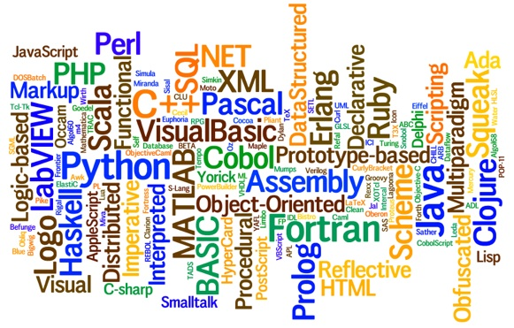
Programming Language

Slide 41
Types of Computer languages
Architecture description
Hardware description
Markup
Modeling
Programming
Query
Specification
Stylesheet
Template processing
Transformation

Slide 42
1 Array language
2 Aspect-oriented languages
3 Assembly languages
4 Authoring languages
5 Command line interface languages
6 Compiled languages
7 Concurrent languages
8 Curly-bracket languages
9 Dataflow languages
10 Data-oriented languages
11 Data-structured languages
12 Declarative languages
13 Embeddable languages
14 Esoteric languages
15 Extension languages
16 Fourth-generation languages
17 Functional languages
18 Imperative languages
19 Interactive mode languages
20 Interpreted languages
21 Iterative languages
22 List-based languages – LISPs
23 Little languages
24 Logic-based languages
25 Machine languages
26 Macro languages
27 Metaprogramming languages
28 Multiparadigm languages
29 Numerical analysis
30 Non-English-based languages
31 Object-oriented class-based languages
32 Object-oriented prototype-based languages
33 Off-side rule languages
34 Procedural languages
35 Reflective languages
36 Rule-based languages
37 Scripting languages
38 Stack-based languages
39 Synchronous languages
40 Syntax handling languages
41 Visual languages
42 Wirth languages
43 XML-based languages
Notes:
Curly Bracket Programming Languages: C, Java, C++, Perl, JavaScript, PHP, Ruby, Bcpl, awk, Quakec, Objective-C, Cyclone, Pike, Unrealscript, Rc [Perfect Paperback]
curly brackets
美
英
un.波形括号
网络大括号；花括号；蜷括弧
esoteric [[,esə'terɪk; ,iːsə-]]
基本翻译
adj. 秘传的；限于圈内人的；难懂的
网络释义
Esoteric:第一极品 | 秘传的 | 机密的
13 Embeddable languages
13.1 In source code
13.1.1 Server side
13.1.2 Client side
13.2 In object code
17 Functional languages
17.1 Pure
17.2 Impure
26 Macro languages
26.1 Textual substitution macro languages
26.2 Application macro languages
31 Object-oriented class-based languages
31.1 Multiple dispatch
31.2 Single dispatch
Array · Aspect-oriented · Assembly · Class-based · Compiled · Concurrent · Curly bracket · Data-structured · Dataflow · Declarative · Domain-specific · Dynamic · Esoteric · Event-driven · Extensible · Functional · High-level · Imperative · Interpreted · Logic · Low-level · Machine · Macro · Metaprogramming · Multi-paradigm · Non-English-based · Object-oriented · Off-side rule · Pipeline · Procedural · Prototype-based · Reflective · Rule-based · Scripting · Synchronous · Visual

Slide 43
How many types of programming language
Imperative
Object-oriented
Functional
Logical
Notes:
Many programming languages require computation to be specified in an imperative form (i.e., as a sequence of operations to perform), while other languages utilize other forms of program specification such as the declarative form (i.e. the desired result is specified, not how to achieve it).

Slide 44
What is programming language?
Artificial language
A programming language is a formal constructed language designed to communicate instructions to a machine, particularly a computer.
Programming languages can be used to create programs to control the behavior of a machine or to express algorithms.
Programming languages differ from natural languages
natural languages are only used for interaction between people
programming languages also allow humans to communicate instructions to machines.

Slide 45
Programs are written and read by humans but are executed by computers.
Since both humans and computers must be able to understand programs, it is necessary to understand the requirements of both classes of users.
The native programming languages of computers bear little resemblance to natural languages.
Machine languages are unstructured and contain few, if any, constructs resembling the level at which humans think.
The instructions typically include arithmetic and logical operations, memory modification instructions and branching instructions.
Notes:
resemblance [[rɪ'zembl(ə)ns]]
基本翻译
n. 相似；相似之处；相似物；肖像
网络释义
resemblance:相似 | 相像 | 相似性

Slide 46
For example, the circumference computation might be written in assembly language as:
Load Radius R1
Mult R1 2 R1
Load Pi R2
Mult R1 R2 R1
Store R1 Circumference
imperative programs have tended to be more efficient in their use of time and space than equivalent functional and logic programs.
Because the imperative model is closer to actual hardware,

Slide 47
Natural languages are not suitable for programming languages
because humans themselves do not use natural languages when they construct precise formulations of concepts and principles of particular knowledge domains.
Instead, they use a mix of natural language, formalized symbolic notations of mathematics and logic and diagrams.
The most successful of these symbolic notations contain a few basic objects which may be combined through a few simple rules to produce objects of arbitrary levels of complexity.
In these systems, humans reduce complexity by the use of definitions, abstractions, generalizations and analogies.
Notes:
arbitrary level
基本翻译
【考古学】任意水平
cater to
基本翻译
迎合；为…服务
网络释义
cater to:迎合 | 款待 | 满足

Slide 48
Successful programming languages do the same by catering to the natural problem solving approaches used by humans.
Ideally, programming languages should approach the level at which humans reason and should reflect the notational approaches that humans use in problem solving and must include ways of structuring programs to ease the tasks of program understanding, debugging and maintenance.

Slide 49
How to define programming language?
The description of a programming language is usually split into the two components of syntax (form) and semantics (meaning).
defined by a specification document
the C programming language is specified by an ISO Standard
other languages have a dominant implementation that is treated as a reference
Python,Google GO,Haskell,Ruby,Perl
Notes:
communicate sth to sb - 必应词典
网络把……传达给某人；把传递给某人；传送某事物给某人
A programming language is a formal constructed language designed to communicate instructions to a machine, particularly a computer. Programming languages can be used to create programs to control the behavior of a machine or to express algorithms.
The earliest programming languages preceded the invention of the digital computer and were used to direct the behavior of machines such as Jacquard looms and player pianos.^{[1]} Thousands of different programming languages have been created, mainly in the computer field, and many more still are being created every year. Many programming languages require computation to be specified in an imperative form (i.e., as a sequence of operations to perform), while other languages utilize other forms of program specification such as the declarative form (i.e. the desired result is specified, not how to achieve it).
The description of a programming language is usually split into the two components of syntax (form) and semantics (meaning). Some languages are defined by a specification document (for example, the C programming language is specified by an ISO Standard), while other languages (such as Perl) have a dominant implementation that is treated as a reference.

Slide 50
Design idea
Traits often considered important for what constitutes a programming language include:
Function and target
Abstractions
Expressive power
Notes:
traits
基本翻译
n. 特性，特质，性格（trait的复数）
网络释义
Traits:特质 | 特性 | 性状
Constitutes
构成，组成，成为…的本质

Slide 51
Function and target:
A computer programming language is a language used to write computer programs, which involve a computer performing some kind of computation or algorithm and possibly control external devices such as printers, disk drives, robots,and so on.
PostScript programs are frequently created by another program to control a computer printer or display.
More generally, a programming language may describe computation on some, possibly abstract, machine.
Notes:
It is generally accepted that a complete specification for a programming language includes a description, possibly idealized, of a machine or processor for that language.
In most practical contexts, a programming language involves a computer; consequently, programming languages are usually defined and studied this way.

Slide 52
Abstractions
Programming languages usually contain abstractions for defining and manipulating data structures or controlling the flow of execution.
The practical necessity that a programming language support adequate abstractions is expressed by the abstraction principle
this principle is sometimes formulated as recommendation to the programmer to make proper use of such abstractions.

Slide 53
Expressive power
The theory of computation classifies languages by the computations they are capable of expressing.
All Turing complete languages can implement the same set of algorithms.
ANSI/ISO SQL and Charity are examples of languages that are not Turing complete, yet often called programming languages.
Notes:
Markup languages like XML, HTML or troff, which define structured data, are not usually considered programming languages.^{[12][13][14]} Programming languages may, however, share the syntax with markup languages if a computational semantics is defined. XSLT, for example, is a Turing complete XML dialect.^{[15][16][17]} Moreover, LaTeX, which is mostly used for structuring documents, also contains a Turing complete subset.^{[18][19]}
The term computer language is sometimes used interchangeably with programming language.^{[20]} However, the usage of both terms varies among authors, including the exact scope of each. One usage describes programming languages as a subset of computer languages.^{[21]} In this vein, languages used in computing that have a different goal than expressing computer programs are generically designated computer languages. For instance, markup languages are sometimes referred to as computer languages to emphasize that they are not meant to be used for programming.^{[22]}
Another usage regards programming languages as theoretical constructs for programming abstract machines, and computer languages as the subset thereof that runs on physical computers, which have finite hardware resources.^{[23]} John C. Reynolds emphasizes that formal specification languages are just as much programming languages as are the languages intended for execution. He also argues that textual and even graphical input formats that affect the behavior of a computer are programming languages, despite the fact they are commonly not Turing-complete, and remarks that ignorance of programming language concepts is the reason for many flaws in input formats.^{[24]}

Slide 54
Computer language /Programming language
Markup languages like XML or HTML which define structured data, are not usually considered programming languages
Programming languages may, however, share the syntax with markup languages if a computational semantics is defined. XSLT, for example, is a Turing complete XML dialect
LaTeX, which is mostly used for structuring documents, also contains a Turing complete subset
interchangeably
Notes:
The term computer language is sometimes used interchangeably with programming language.[20] However, the usage of both terms varies among authors, including the exact scope of each. One usage describes programming languages as a subset of computer languages.[21] In this vein, languages used in computing that have a different goal than expressing computer programs are generically designated computer languages. For instance, markup languages are sometimes referred to as computer languages to emphasize that they are not meant to be used for programming.[22]

Slide 55
Q0:Yet can we really say that
Java is ``better'' (or ``worse'') than C++?
Is Scheme ``better'' than Lisp?
Is ML ``better'' than either of them?

Slide 56
One language may occupy the greater number of programmer hours
A different one have more lines of code,
A third may utilize the most CPU time, and so on.

Slide 57
Pros and cons
Some languages are very popular for particular kinds of applications.
COBOL is still strong in the corporate data center, often on large mainframes;
FORTRAN in engineering applications;
C in embedded applications and operating systems;
and other languages are regularly used to write many different kinds of applications.
C++
Java

